Slide 1
VLSI Design: Introduction
The Beginning of Semiconductor Electronics
Notes:
Good Morning!
The title of today’s talk is “On some Planar Partitioning Problems”.

Slide 2
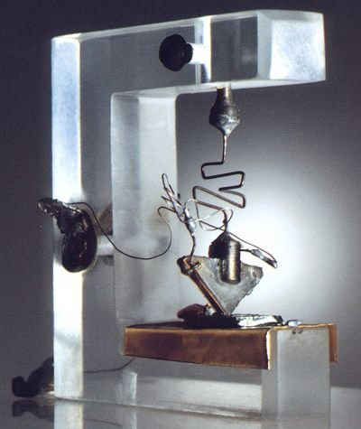
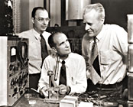
The Birth of Semiconductor Age:
December 23, 1947
From left: Bardeen, Schokley, Brattain
Nobel Winners of Physics in 1956
First Point Contact Transistor of Bardeen and Brattain
Notes:
Good Morning!
The title of today’s talk is “On some Planar Partitioning Problems”.

Slide 3
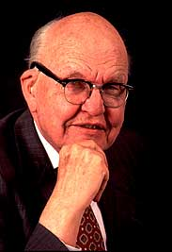
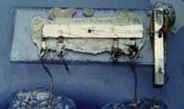
The Miniaturization of Electronics
Jack Kilby and his Integrated Circuit (1958)
Notes:
Good Morning!
The title of today’s talk is “On some Planar Partitioning Problems”.

Slide 4
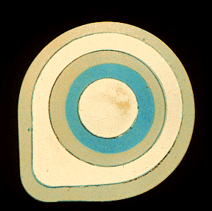
1959 - Practical Integrated Circuits
Robert Noyce of Fairchild Camera and Instrument Corp. constructed the practical integrated circuit, which allowed conducting channels to be printed directly on the silicon surface
Notes:
Good Morning!
The title of today’s talk is “On some Planar Partitioning Problems”.

Slide 5
ENIAC vs. Microcomputer (1977)
Its Impact in Two Decades
ENIAC
Size : 30 x 50 ft
Weight : 30 tons
Tubes : 18 K
Resistors: 70 K
Capacitors : 10 K
Switches : 6 K
Power : 150 kW
Cost (1940) : US $ 400 K
Microcomputer
Size : ¼ inch x ¼ inch
Weight : nil
Power < light bilb
Speed : 20 times faster
Memory : larger, more computing capacity
Cost < $300 (compare with $ 400 K + inflation over 34 years).
Notes:
Good Morning!
The title of today’s talk is “On some Planar Partitioning Problems”.

Slide 6
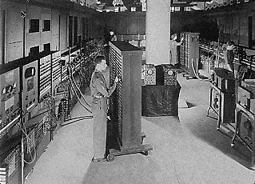

First Modern Digital Computer: ENIAC (Electronic Numerical Integrator And Calculator)
Notes:
Good Morning!
The title of today’s talk is “On some Planar Partitioning Problems”.

Slide 7
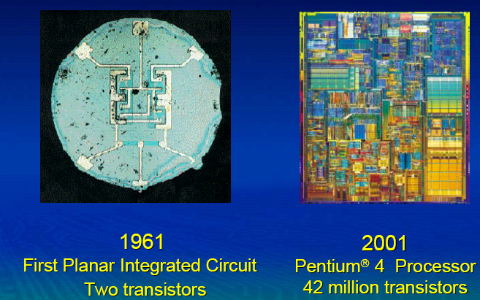
Four Decades of ICs
Notes:
Good Morning!
The title of today’s talk is “On some Planar Partitioning Problems”.

Slide 8
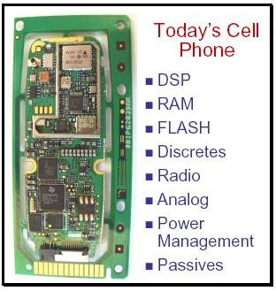
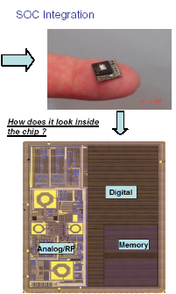
Notes:
Good Morning!
The title of today’s talk is “On some Planar Partitioning Problems”.

Slide 9


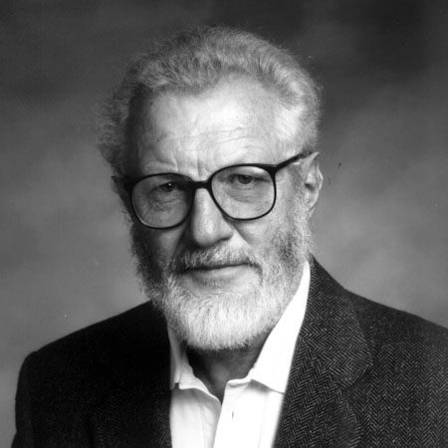
Nobel Prizes 2000
The Royal Swedish Academy of Sciences has decided to award the Nobel Prize in Physics for 2000 to scientists and inventors whose work has laid the foundation of modern information technology, IT, particularly through their invention of rapid transistors, laser diodes, and integrated circuits (chips).
The prize is being awarded with one half jointly to
Zhores I. Alferov
A.F. Ioffe Physico-Technical Institute, St. Petersburg, Russia, and
Herbert Kroemer
University of California at Santa Barbara, California, USA,
"for developing semiconductor heterostructures used in high-speed- and opto-electronics"
and one half to
Jack S. Kilby
Texas Instruments, Dallas, Texas, USA
"for his part in the invention of the integrated circuit”

Slide 10
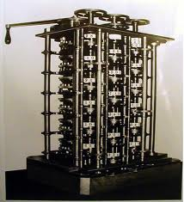
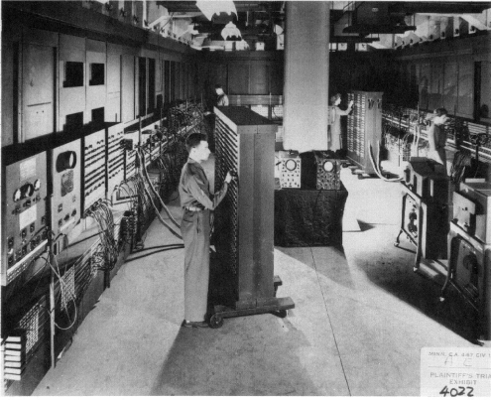
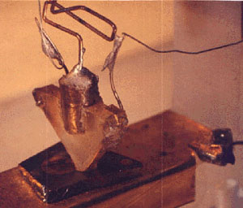
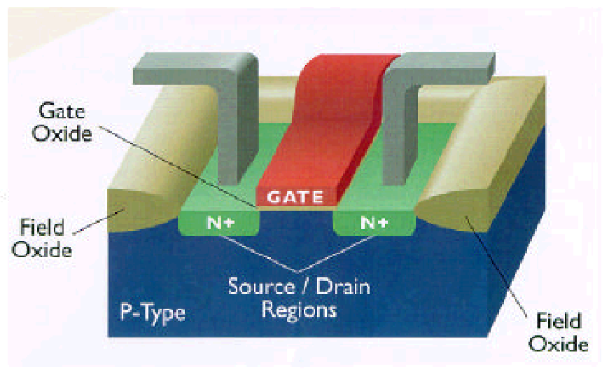
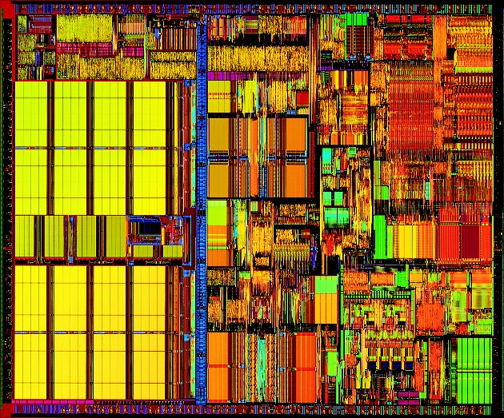
The Historical Journey
1832: Babbage Difference
Engine (25000 parts)
1946: ENIAC (1500 sq. ft.)
1948: First Transistor
A complete processor on chip
System-on-a-chip
Network-on-a-chip
An n-MOS transistor on Silicon

Slide 11
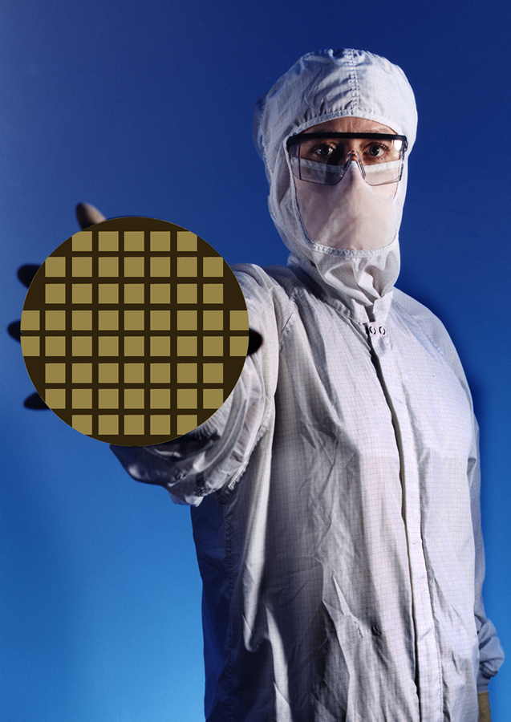
Transforming Sandpile to IC Chips
Silicon wafer
Diam = 8 to12 inches
die

Slide 12
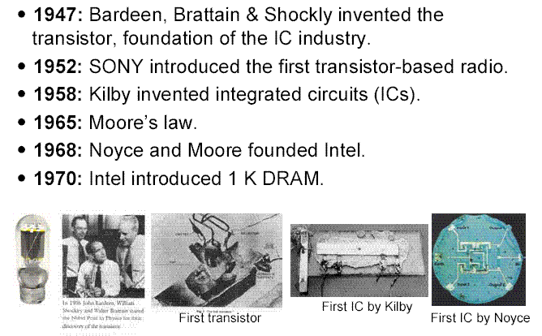
Milestones of IC Industry

Slide 13
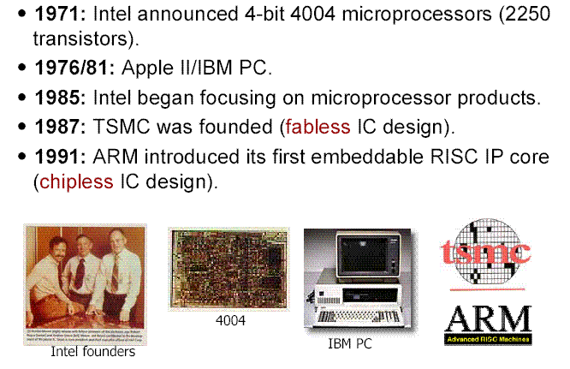
Milestones of IC Industry (2)

Slide 14
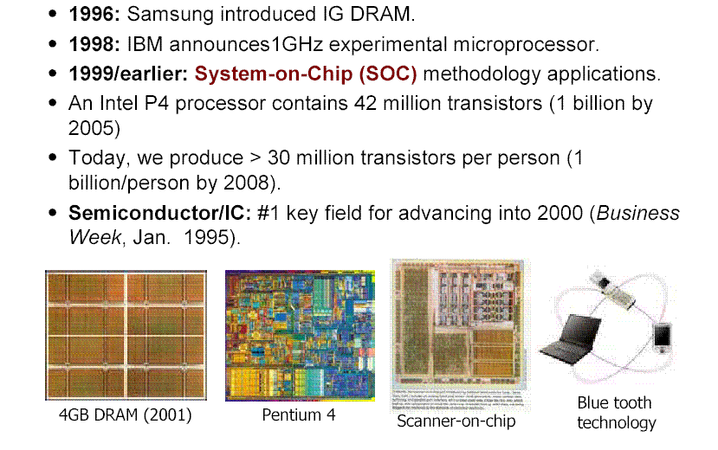
Milestones of IC Industry (3)

Slide 15
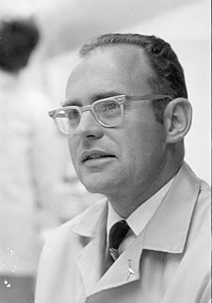
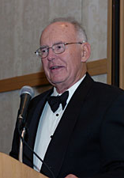
Gordon E. Moore

Slide 16
Gordon Moore: 1965
Predicted that the number of transistors integrated on a die would grow exponentially (doubling every 12 to 18 months)
Million transistors/chip barrier crossed in the 1980s
Today:
  55 Million, 2 GHz clock (Intel P4)
  140 Million transistor (HP PA-8500)

Slide 17
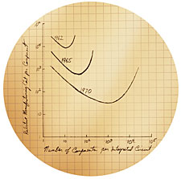
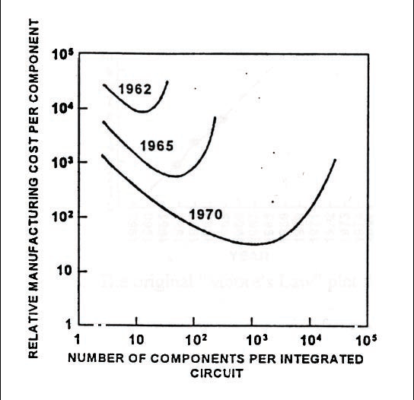
Moore’s 1965 Graph
1975

Slide 18
1975
“Progress in Digital Integrated Electronics,” IEDM Tech. Digest, 1975, pp. 11-13.
. . . the rate of increase of complexity can be expected to change slope in the next few years as shown in Figure 5. The new slope might approximate a doubling every two years, rather than every year, by the end of the decade.

Slide 19
Figure 5 of Moore’s 1975 Paper
16M
1M
64K
4K
256
16
1
Components per chip
60 65 70 75 80 85
Year

Slide 20
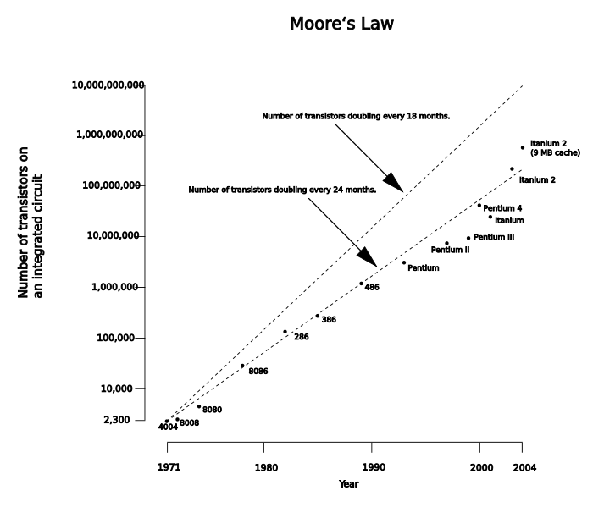
Moore’s Law

Slide 21
Power Dissipation
100
P6
Pentium ® proc
10
286
486
Power (Watts)
8086
386
8085
1
8080
8008
4004
0.1
1971
1974
1978
1985
1992
2000
Year
Lead Microprocessors power continues to increase
Courtesy, Intel

Slide 22
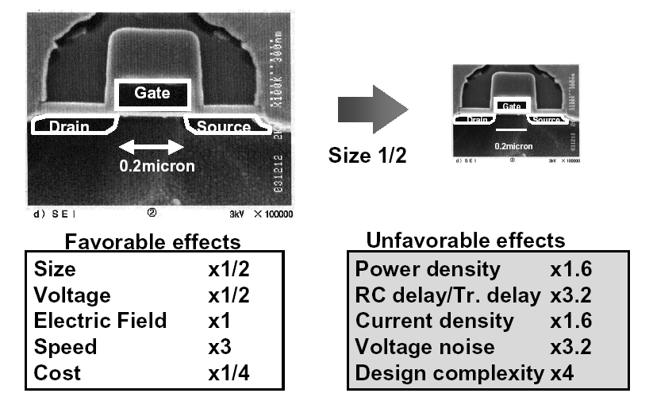
Scaling Law

Slide 23
VLSI Realization Process
Customer’s need
Design
Determine requirements
Write specifications
Design synthesis and Verification
Test development
Fabrication
Manufacturing test
Manufacture
Chips to customer
Jadavpur University - 2011

Slide 24
2011
Problems with technology:
  High power consumption
    Power density
    Leakage
  Process variation – larger as a fraction of feature size
  Increased noise sensitivity
Problems with design:
  Verification of correctness – logic and timing
  Ensuring reliable operation
  Testing

Slide 25
VLSI Design Issues
Notes:
Good Morning!
The title of today’s talk is “On some Planar Partitioning Problems”.

Slide 26
Complexity Acronyms
SSI = small scale integration (~100 components)
MSI = medium scale integration (~1000 components)
LSI = large scale integration (~10⁵ components)
VLSI = very large scale integration (~10⁵ - 10⁶ components)
ULSI = ultra large scale integration (~10⁶ - 10⁹ components)
GSI = giga-scale integration (> 10⁹ components)

Slide 27

Design Issues and Metrics
Cost
Reliability
Speed
Power
Energy dissipation
Time-to-market

Slide 28
VLSI Chip Yield
A manufacturing defect is a finite chip area with electrically malfunctioning circuitry caused by errors in the fabrication process.
A chip with no manufacturing defect is called a good chip.
Fraction (or percentage) of good chips produced in a manufacturing process is called the yield. Yield is denoted by symbol Y.
Notes:
2

Slide 29
Importance of Yield
Cost of a chip =
Cost of fabricating and testing a wafer
⎯⎯⎯⎯⎯⎯⎯⎯⎯⎯⎯⎯⎯⎯⎯⎯⎯⎯⎯
Yield × Number of chip sites on the wafer

Slide 30
Clustered VLSI Defects
Good chips
Faulty chips
Defects
Wafer
Unclustered defects
Wafer yield = 12/22 = 0.55
Clustered defects (VLSI)
Wafer yield = 17/22 = 0.77
Notes:
3

Slide 31
Defining Terms
Design synthesis: Given an I/O function, develop a procedure to manufacture a device using known materials and processes.
Verification: Predictive analysis to ensure that the synthesized design, when manufactured, will perform the given I/O function.
Test:
  Characterization: A test that debugs test program by fault diagnosis.
  Manufacturing test: A step that ensures that the physical device, manufactured from the synthesized design, has no manufacturing defect.

Slide 32
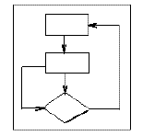
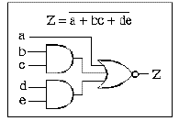
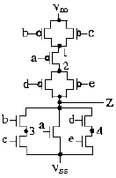
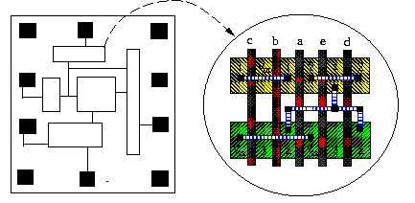
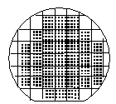

VLSI Design Flow
System Specification
functional simulation
specification
Function/architecture Design
logic simulation
behavioral representation
Logic Synthesis
circuit analysis
structural representation
Circuit Design
extraction & verification
structural representation
Physical Synthesis
physical representation
Fabrication
Packaging

Slide 33
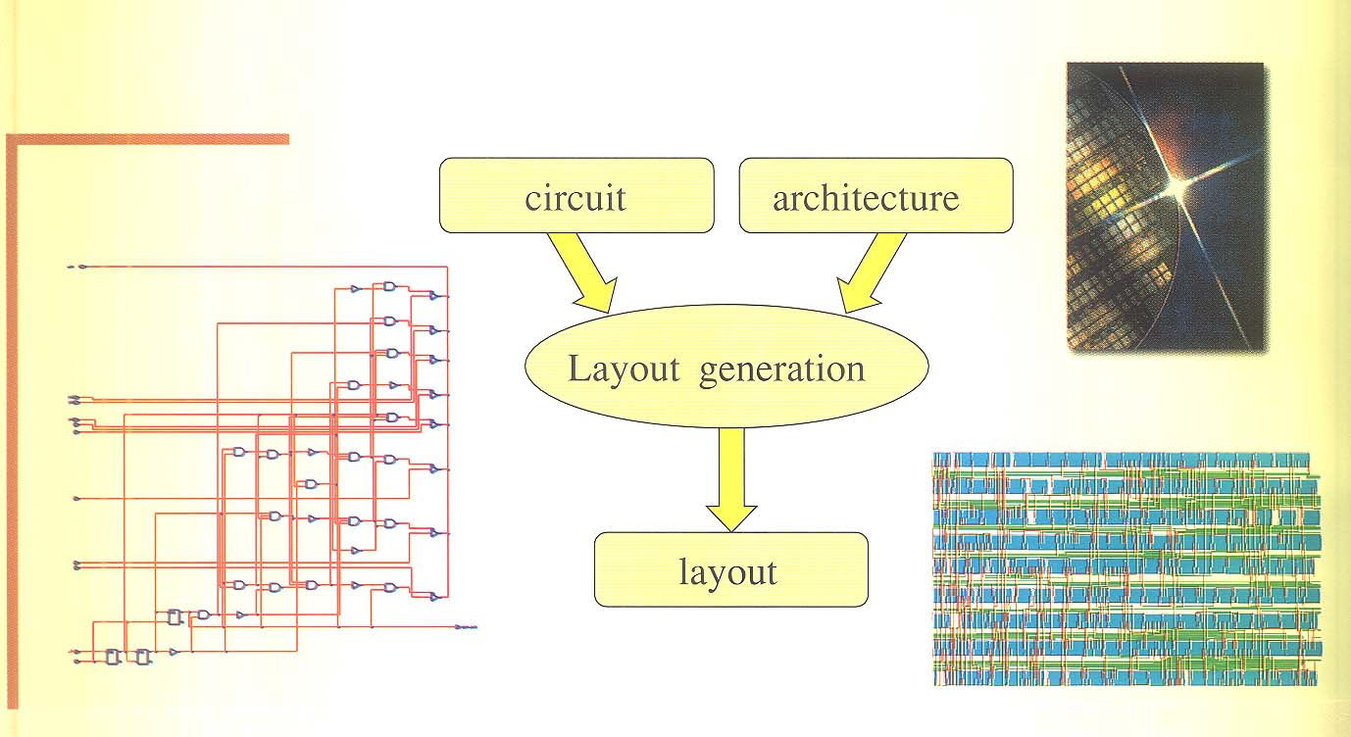
Physical Design

Slide 34
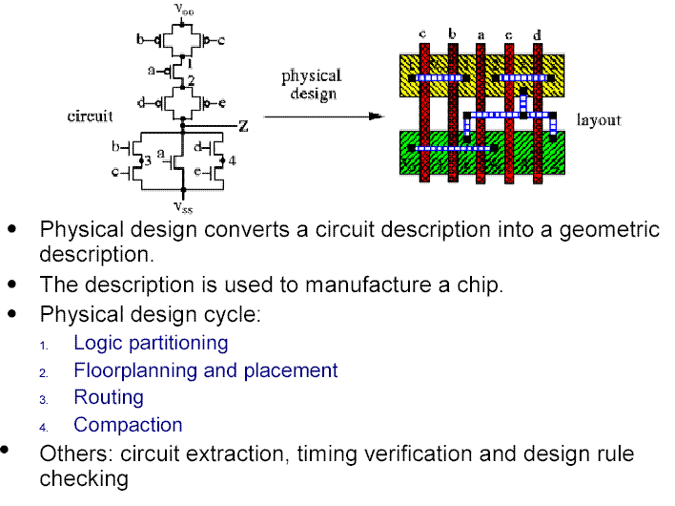
Physical Design

Slide 35
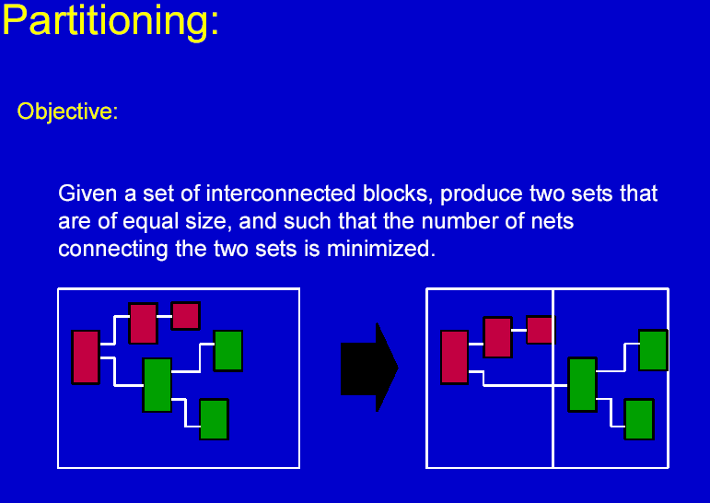
Jadavpur University - Oct. 17, 2005

Slide 36
Circuit Partitioning: A Graph-Theoretic Problem
1
5
1
5
2
6
2
6
cut cost = 1
3
7
3
7
4
8
4
8
cut cost = 9

Slide 37
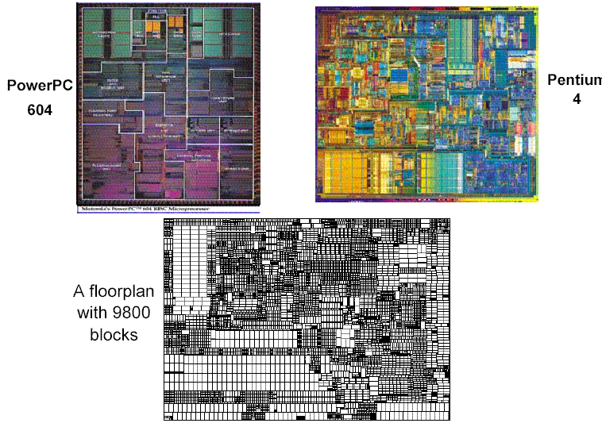
Floorplanning
Set up a plan for a good layout of slots, where the modules can be placed
Jadavpur University - Oct. 17, 2005

Slide 38
Floorplan Examples

Slide 39
VLSI Placement – A Combinatorial Problem
A
B
C
D
E
F
G
H
A set of blocks/cells
2
2
3
D
F
3
1
4
B
1
4
A
5
8
G
8
5
H
7
C
7
6
E
9
6
9
A floorplan
A placement on the floor
Number of different placements for 1000 cells in a 1000-room floor is 1000! (approximately 10²⁵⁶²)

Slide 40
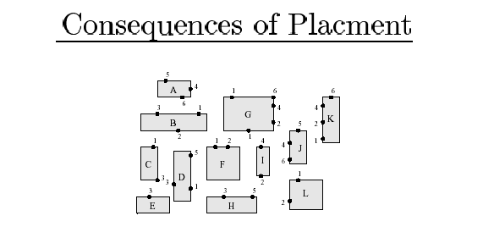
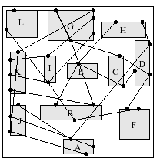
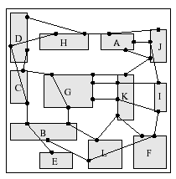
VLSI Placement - An Example
terminals of net 2
Fixed-size blocks to be placed
A bad placement
A good placement

Slide 41
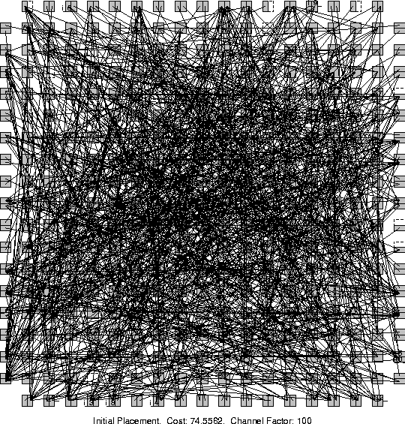

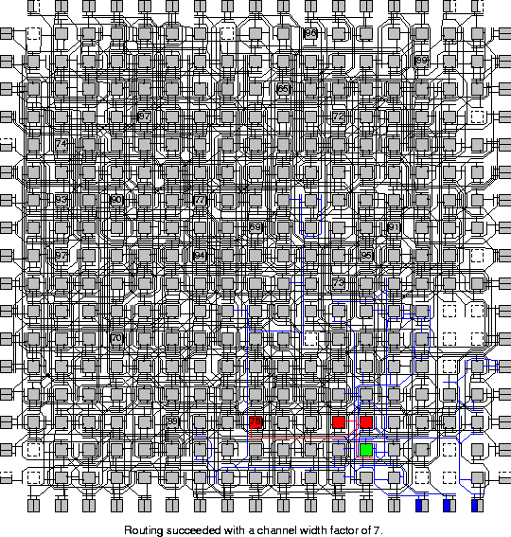
Placement can Make a Difference
MCNC Benchmark circuit e64 placed on FPGA
Random Initial
Placement
Final
Placement
After Detailed
Routing
Jadavpur University - Oct. 17, 2005

Slide 42
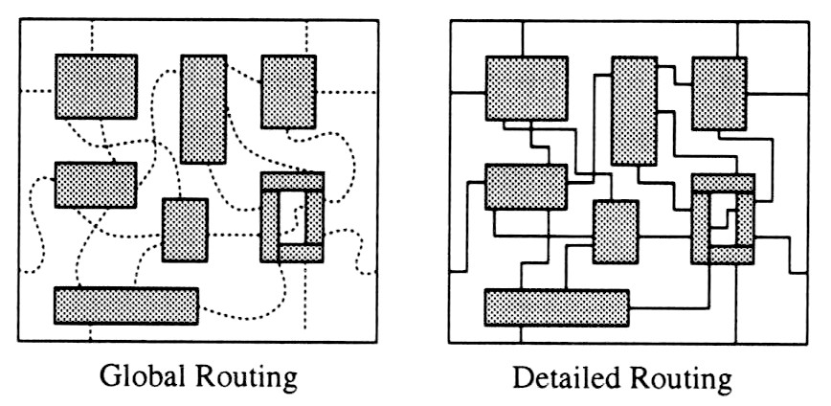
Routing
Complete the interconnections among modules. Factors like critical path, clock skew, crosstalk, congestion, repeater placement, wire spacing, … are considered. Includes global routing and detailed routing.
Around 60% of the overall design time is spent on routing!!
Jadavpur University - Oct. 17, 2005

Slide 43
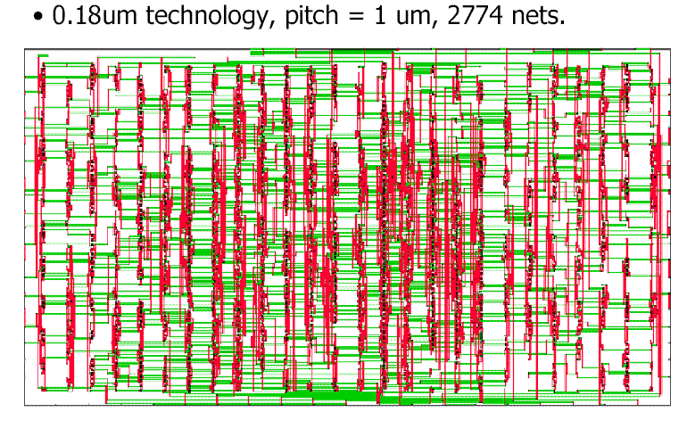
Routing Example

Slide 44
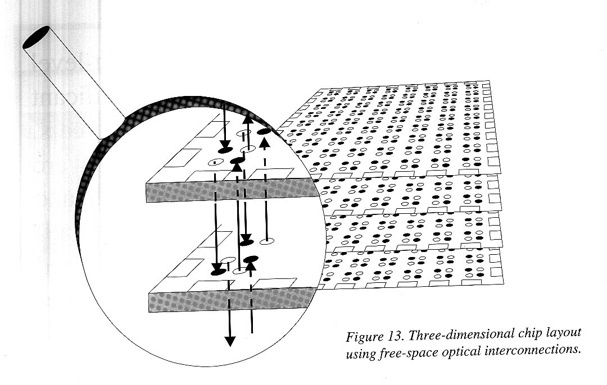
Routing Example
Three-dimensional chip layout using optical interconnection
D. Stroobandt, Recent advances in system-level interconnect prediction, IEEE Circuits and Systems Magazine, vol. 11 (4), 2000

Slide 45
VLSI Design: An Interdisciplinary Challenge
Boolean Algebra (George Boole, 1886)
Quantum Mechanics
Semiconductor Physics
Logic Synthesis (Claude Shannon, 1936)
Semiconductor Devices (e.g., Transistors)
Finite Automata and Sequential Machines (1950 -1960)
VLSI
Micro-electronics, IC Fabrication Technology Photolithography, MBE
Design
Circuit Theory, Analog and Mixed Signal Design
Synthesis, Testing, Verification Techniques
Physical Design
Evolution of computer systems and software techniques
Electronic Design Automation (CAD Tools)
Graph Theory
Computational Geometry
Design and Analysis of Algorithms

